Slide 1
Deep Convolutional Neural Networks
By: Terra Miller

Slide 2
overview
Neural Network Overview
Convolutional Layers
Convolution
Activation Functions
Pooling Layers
Classification: Fully-Connected Layers
Dropout Function
Applications

Slide 3
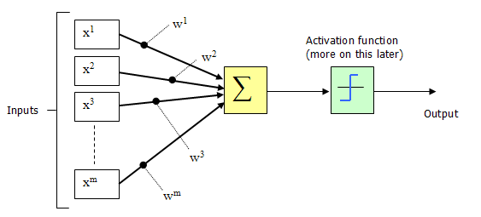
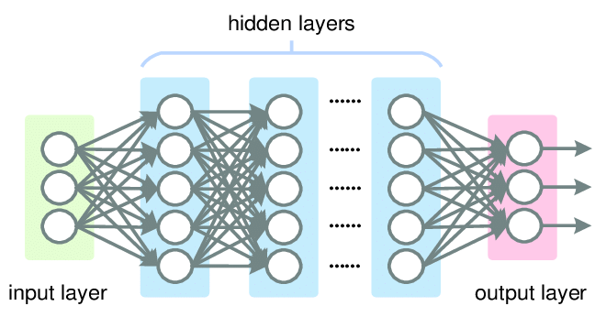
Neural Networks
Neuron (unit) – a single node within a neural network
Neural Network – comprised of many neurons that make up various layers
https://www.codeproject.com/Articles/16419/AI-Neural-Network-for-beginners-Part-of
https://hackernoon.com/challenges-in-deep-learning-57bbf6e73bb

Slide 4
What Is a Deep CNN?
https://towardsdatascience.com/build-your-own-convolution-neural-network-in-5-mins-4217c2cf964f

Slide 5
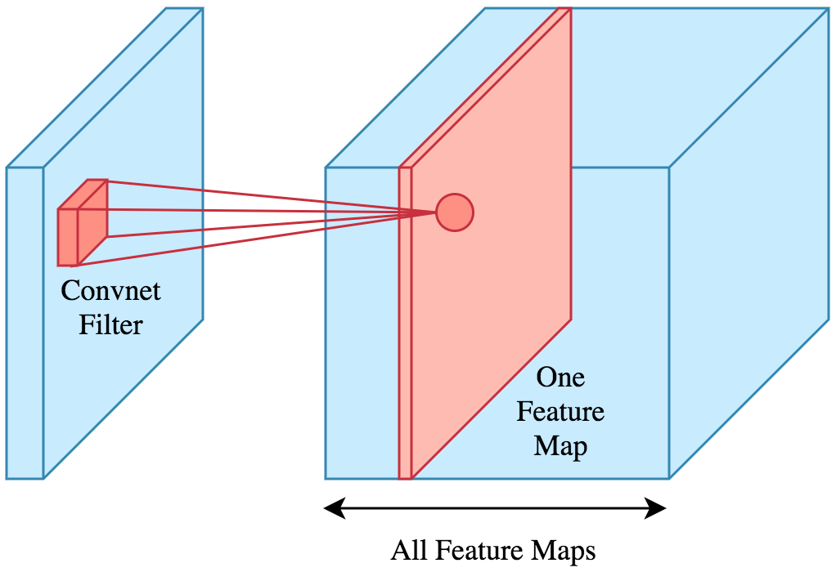
Convolutional Layers
Performs convolution on matrices
Applies filters to original input data
Introduces nonlinearity to feature maps using activation functions
Hyperparameters:
Depth
Stride
Type of Convolution
https://towardsdatascience.com/applied-deep-learning-part-4-convolutional-neural-networks-584bc134c1e2

Slide 6
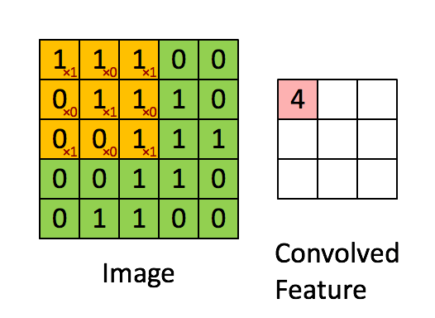
Convolution
Two simple calculations:
Element-wise multiplication
Summation of results
Purpose: allows for feature extraction from input data
This Photo by Unknown Author is licensed under CC BY-SA

Slide 7
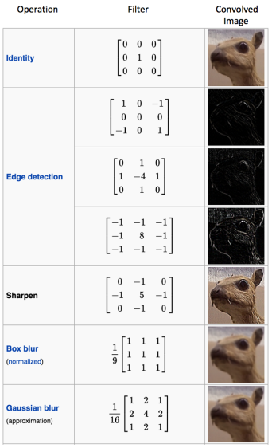
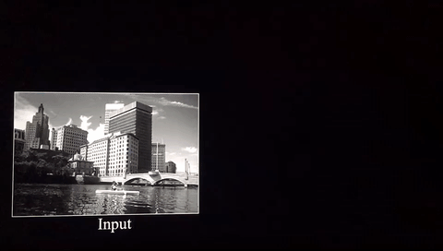
https://ujjwalkarn.me/2016/08/11/intuitive-explanation-convnets/
https://ujjwalkarn.me/2016/08/11/intuitive-explanation-convnets/

Slide 8
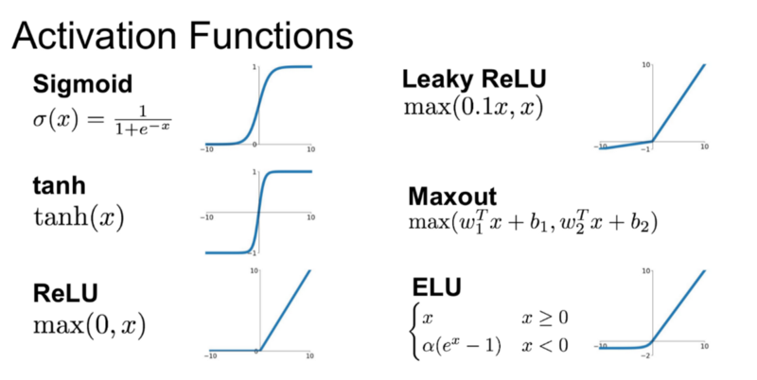
Activation Functions
https://medium.com/@shrutijadon10104776/survey-on-activation-functions-for-deep-learning-9689331ba092

Slide 9
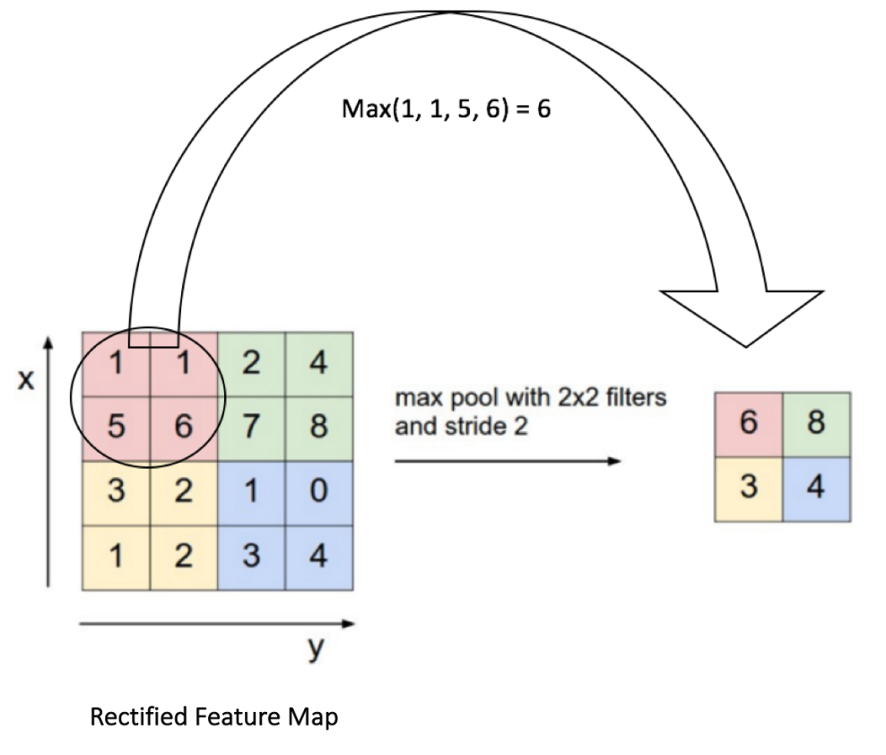
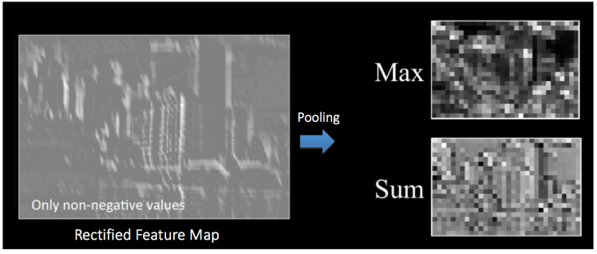
Pooling Layers
Purpose: achieve spatial invariance
Different types of pooling operations:
Max pooling: take the max of the window
Sum pooling: add all of the inputs of the window
Average pooling: take the average of the inputs
Non-Spatial Subsampling: $a_{j}=\tanh{β\sum_{NxN}{a_{i}^{nxn}}+b)}$
https://ujjwalkarn.me/2016/08/11/intuitive-explanation-convnets/
https://ujjwalkarn.me/2016/08/11/intuitive-explanation-convnets/

Slide 10
Classification: Fully-Connected Layers
Total Error is calculated: $\sum{1/2{(target probability −output probability)}^{2}}$
This can also be done using loss functions: Multiclass SVM or Softmax
Train using backpropagation to find gradients of errors with respect to weights
Use gradient descent to update all filter and weight values
https://ujjwalkarn.me/2016/08/11/intuitive-explanation-convnets/

Slide 11
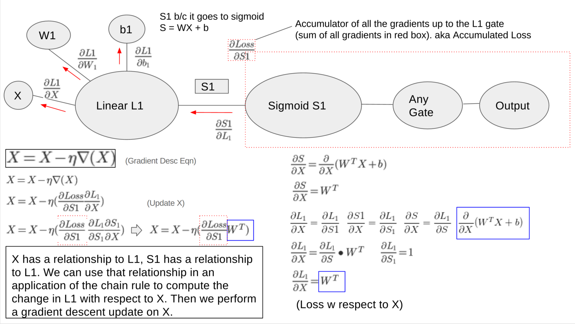
Backpropagation
https://medium.com/@jmitchell1991/backpropagation-explained-654a1a4fd3d7

Slide 12
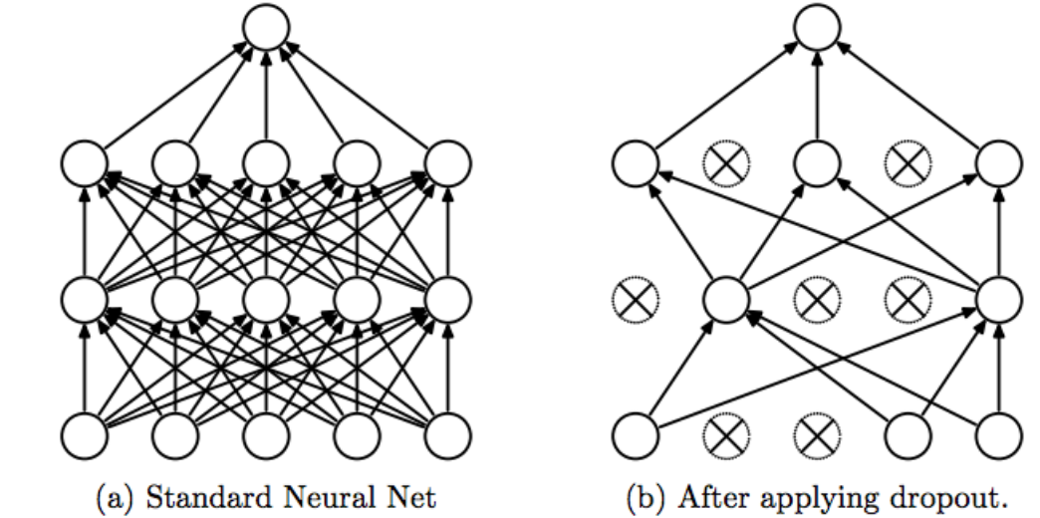
Dropout Function
Problem: overfitting small data sets
Dropout: randomly eliminating nodes and their connections
https://medium.com/@amarbudhiraja/https-medium-com-amarbudhiraja-learning-less-to-learn-better-dropout-in-deep-machine-learning-74334da4bfc5

Slide 13
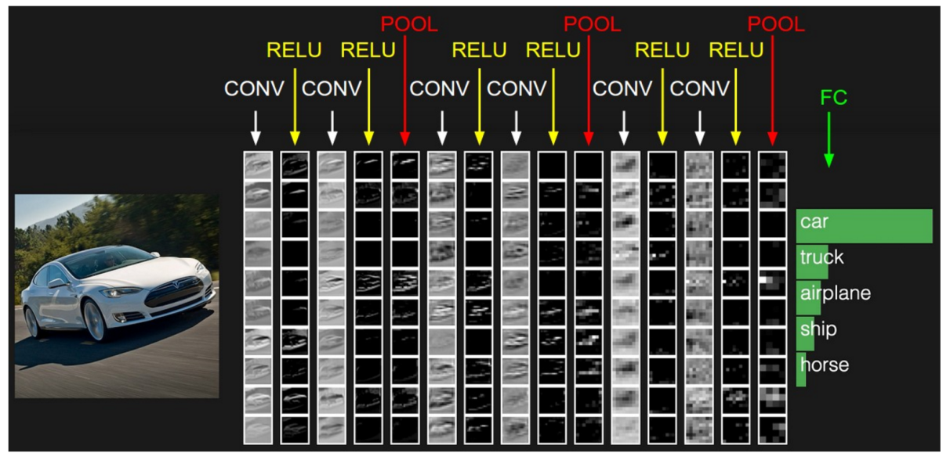
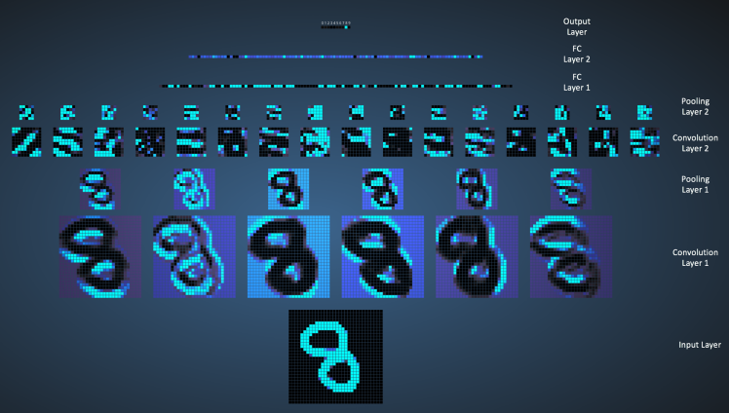
Applications
https://ujjwalkarn.me/2016/08/11/intuitive-explanation-convnets/

Slide 14
Conclusion
Neural Network Overview
Convolutional Layers
Convolution
Activation Functions
Pooling Layers
Classification: Fully-Connected Layers
Dropout Function
Applications

Slide 15
Questions?

Slide 16
References
Agostinelli, Hoffman, Matthew, Sadowski, Peter, Baldi, . . . Forest. (2015, April 21). Learning Activation Functions to Improve Deep Neural Networks. Retrieved November 9, 2018, from https://arxiv.org/abs/1412.6830
Arpathy, K. (n.d.). Linear Classification. Retrieved November 17, 2018, from http://cs231n.github.io/linear-classify
Bhandare, A., Bhide, M., Gokhale, P., & Chandavarkar, R. (2016). Applications of Convolutional Neural Networks. Retrieved November 17, 2018, from http://ijcsit.com/docs/Volume 7/vol7issue5/ijcsit20160705014.pdf
Britz, D. (2016, January 10). Understanding Convolutional Neural Networks for NLP. Retrieved November 10, 2018, from http://www.wildml.com/2015/11/understanding-convolutional-neural-networks-for-nlp
Ciresan, D. C., Meier, U., Masci, J., Gambardella, L. M., & Schmidhuber, J. (2011, July 22). Flexible, high performance convolutional neural networks for image classification. Retrieved November 9, 2018, from https://dl.acm.org/citation.cfm?id=2283603
Jefkine. (2016, September 05). Backpropagation In Convolutional Neural Networks. Retrieved November 17, 2018, from https://www.jefkine.com/general/2016/09/05/backpropagation-in-convolutional-neural-networks/
MATLAB. (n.d.). Times, .*. Retrieved November 17, 2018, from https://www.mathworks.com/help/matlab/ref/times.html
Pedamonti, & Dabal. (2018, April 08). Comparison of non-linear activation functions for deep neural networks on MNIST classification task. Retrieved November 9, 2018, from https://arxiv.org/abs/1804.02763
Scherer, D., Müller, A., & Behnke, S. (2010, September 15). Evaluation of Pooling Operations in Convolutional Architectures for Object Recognition. Retrieved November 9, 2018, from https://link.springer.com/chapter/10.1007/978-3-642-15825-4_10
Sebastian Ruder. (2018, October 24). An overview of gradient descent optimization algorithms. Retrieved November 17, 2018, from http://ruder.io/optimizing-gradient-descent/
Sharma, S. (2017, September 06). Activation Functions: Neural Networks – Towards Data Science. Retrieved November 18, 2018, from https://towardsdatascience.com/activation-functions-neural-networks-1cbd9f8d91d6
Srinivas, Sarvadevabhatla, Kiran, R., Reddy, K., Prabhu, Nikita, . . . Venkatesh, R. (2015, December 10). A Taxonomy of Deep Convolutional Neural Nets for Computer Vision. Retrieved November 10, 2018, from https://www.frontiersin.org/articles/10.3389/frobt.2015.00036/full
Srivastava, N., Hinton, G., Krizhevsky, A., Sutskever, I., & Salakhutdinov, R. (2014). Dropout: A Simple Way to Prevent Neural Networks from Overfitting. Retrieved November 17, 2018, from http://jmlr.org/papers/volume15/srivastava14a.old/srivastava14a.pdf
Ujjwalkarn. (2017, May 29). An Intuitive Explanation of Convolutional Neural Networks. Retrieved November 10, 2018, from https://ujjwalkarn.me/2016/08/11/intuitive-explanation-convnets/
Weisstein, E. W. (2018). Convolution. Retrieved November 18, 2018, from http://mathworld.wolfram.com/Convolution.html

